Slide 1
Self Driving Car Using CNN

Slide 2
CONTENTS
Introduction
Dataset
Loading and Exploring Dataset
Dataset Balancing
Data Preprocessing
Dataset Splitting
Model Architecture
Training & Validation

Slide 3
INTRODUCTION
This code is part of a project that aims to implement behavioral cloning for autonomous driving using deep learning. Behavioral cloning involves training a neural network to mimic the driving behavior of a human driver based on a dataset of images and corresponding steering angles. The neural network is expected to learn the mapping between images captured by the car's cameras and the appropriate steering angles.

Slide 4
Dataset
This code is part of a project for training a neural network to autonomously drive in Udacity's Car Simulator using behavioral cloning. The dataset, sourced from the simulator, undergoes preprocessing, balancing, and splitting. A neural network, based on the NVIDIA model, is constructed and trained. The training history is visualized, and the model is saved for future use. The dataset overview highlights its structure and importance in behavioral cloning. Ultimately, the project aims for the neural network to generalize well on unseen data, paving the way for real-time applications in autonomous driving.
Number of images about 21000

Slide 5
Loading and Exploring Dataset
File paths are extracted and transformed into file names for better representation.
Data points with excessive steering angles are removed to balance the dataset.

Slide 6
Dataset Balancing
The dataset is balanced by removing excess samples from bins with higher occurrences of steering angles.
This ensures a more even distribution and prevents bias towards specific steering angles.

Slide 7
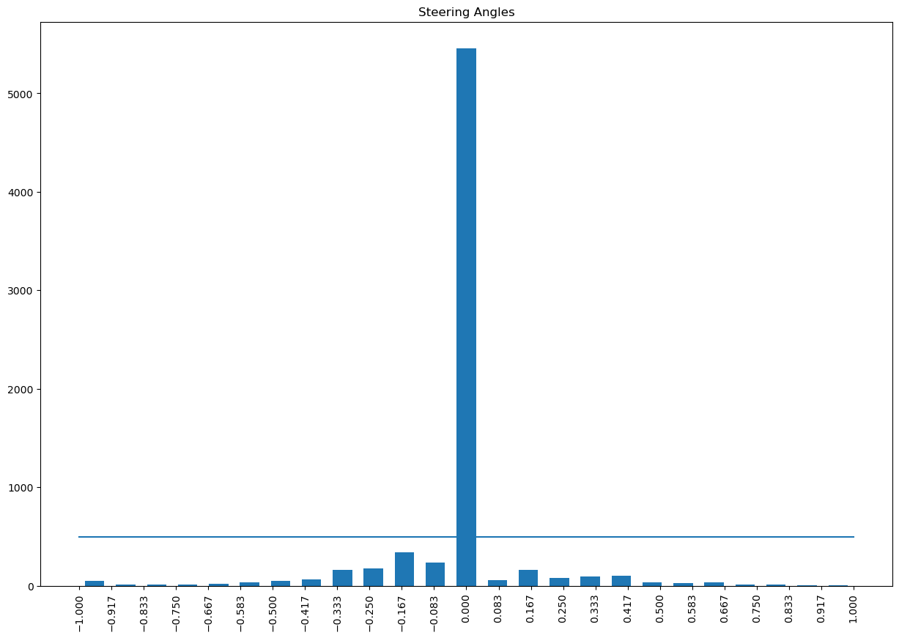
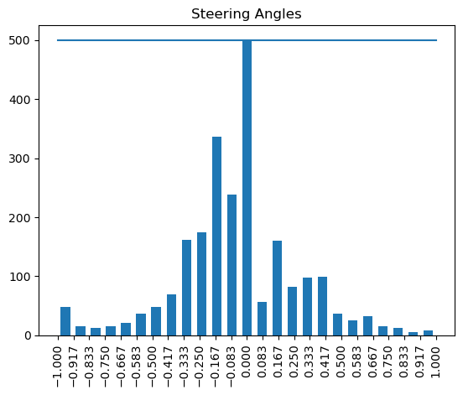
Dataset Balancing
Before Dataset Balancing
After Dataset Balancing

Slide 8
Data Preprocessing
Functions for loading images and steering angles, as well as image preprocessing, are defined.
Image preprocessing involves cropping, converting to YUV color space, applying Gaussian blur, and resizing.

Slide 9
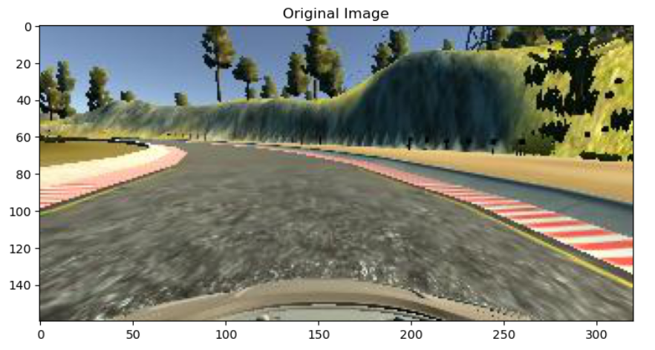
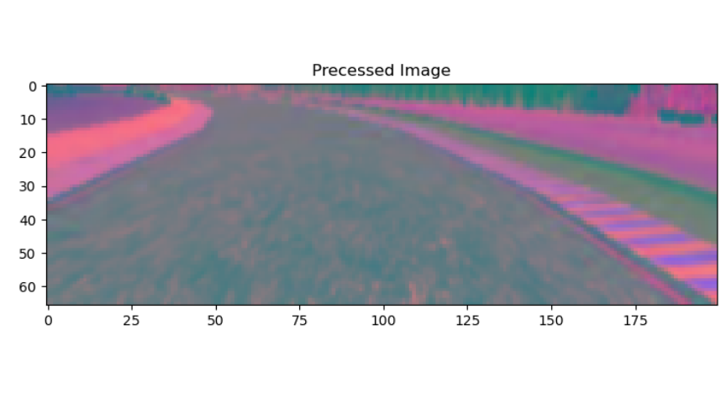
Data Preprocessing
Image Before Preprocessing
Image After Preprocessing

Slide 10
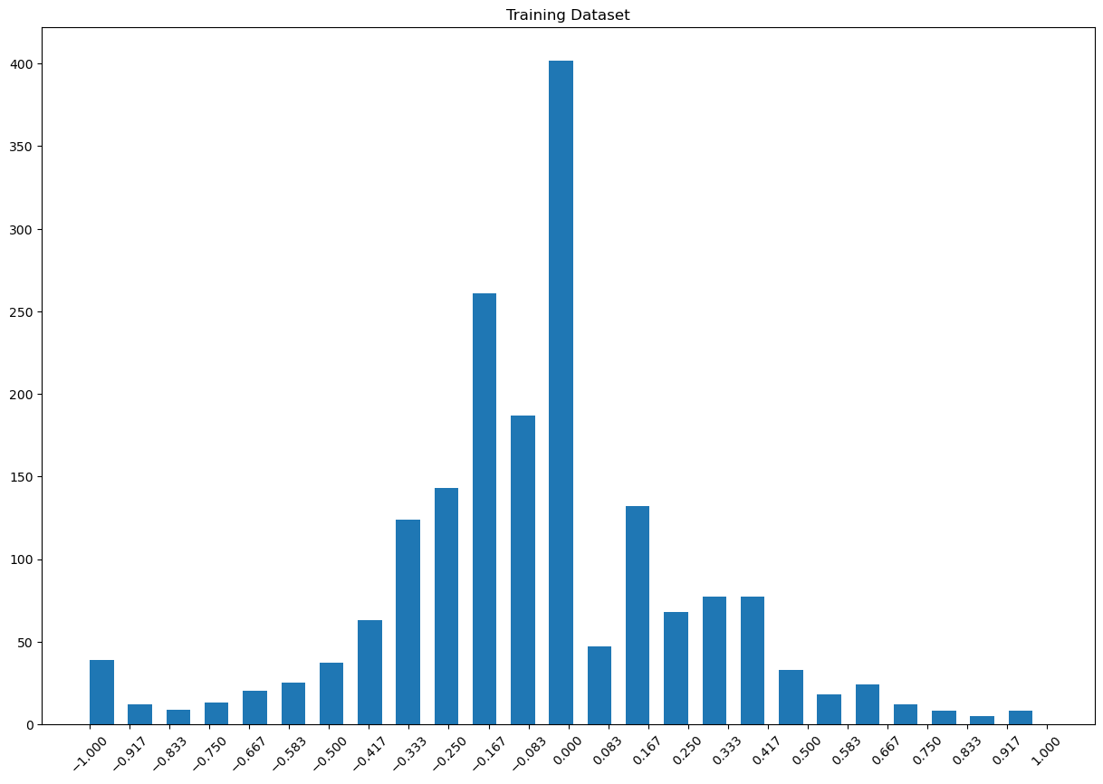
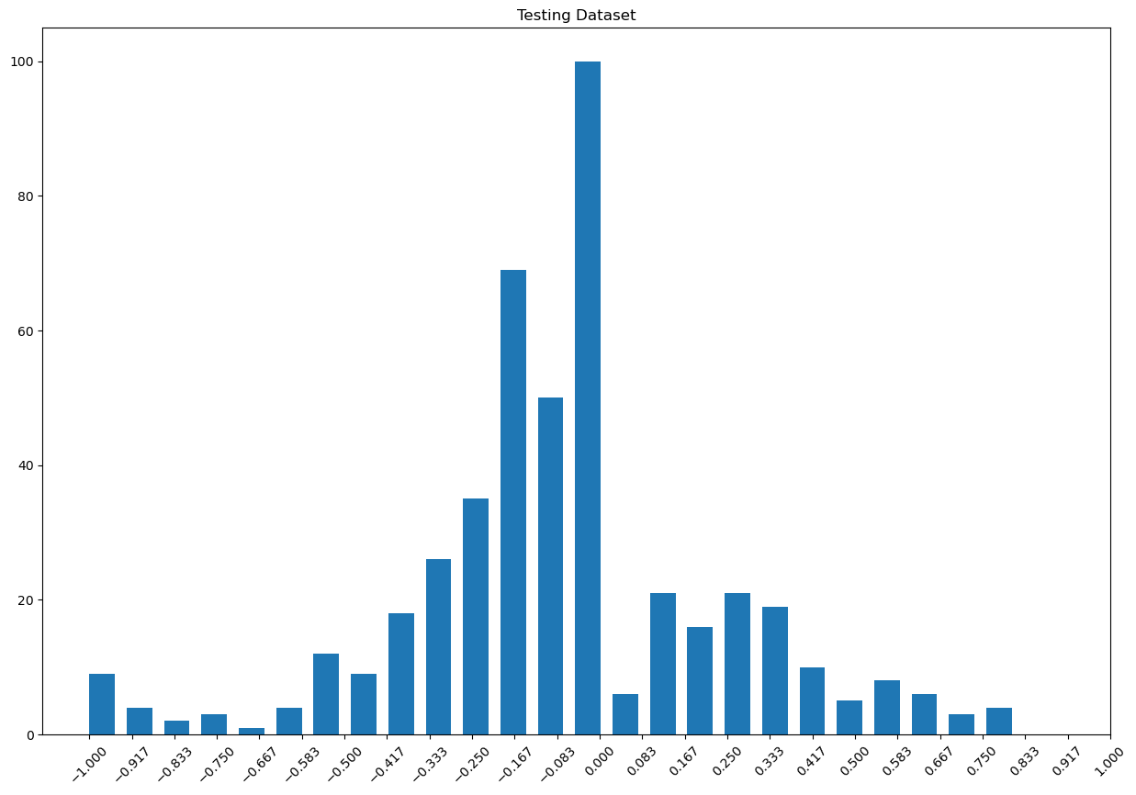
Dataset Splitting
The dataset is split into training and testing sets using the train_test_split function from sklearn.
Training Data
Testing Data

Slide 11
NVIDIA Model Architecture Overview
The NVIDIA model is designed for autonomous vehicle control and features a streamlined architecture:
Convolutional Layers:
5 convolutional layers.
3x3 and 5x5 filters.
Strided convolutions for downsampling.
Dropout Layers:
Interspersed to prevent overfitting.
Flatten Layer:
Converts the output from convolutional layers into a flat vector.

Slide 12
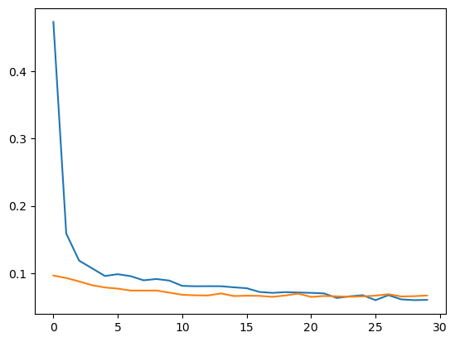
Training & Validation Loss

Slide 13
THANK YOU
Team Members:
Ahmed Talat 221101084
Omar EmadEL-Din 221101037

